Slide 1
RFID AND PASSWORD BASED SECURE TRANSFORMER CONTROL
SESHASAYEE INSTITUTE OF TECHNOLOGY
ELECTRICAL AND ELECTRONIC ENGINEERING
Review-2
S.A Sri sowndariya(201242)
S. Vaishnavee(201247)
M .Gayathri(212259)
Guide: mrs R. SAVITHIRI

Slide 2
OBJECTIVES:
Secured System.
This system operated on password system.
Keypad protection.

Slide 3
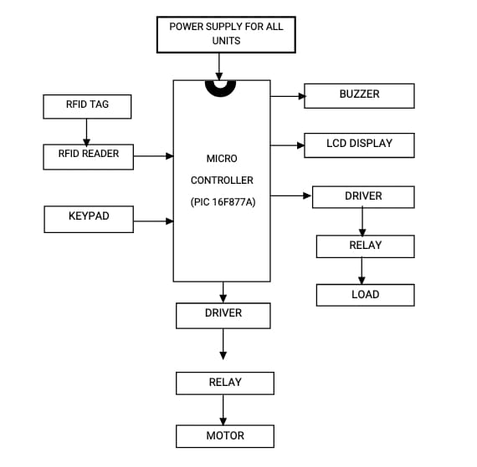
BLOCK DIAGRAM

Slide 4
CONNECTION DIAGRAM

Slide 5
CONCLUSION:
This system provides a solution, which can improve the safety of the project. It is designed to control a circuit breaker with the help of a password. The maintenance staff e.g. Line man’s for control to turn ON/OFF.
The line works with the line man only this system is arrangement such that a password is required to operate the circuit breaker (ON/OFF).
Line man can turn off the supply and comfortably repair it, and return to the substation, then turn on the line by entering the correct or same password.

Slide 6
The system fully controlled by a PIC16F877. If the password entered is correct, then the line can be turned (ON/OFF). Security is prime concern in our day-to-day life. Everyone wants to be more secure as to be possible. This system provides a new approach to a lineman security for their life. The circuit can be used without any fail of a lineman. The circuit can be used without any load can also be controlled when required.

